Slide 1

THE CHRONIC KIDNEY DISEASE PREDICTION AND DIET RECOMMENDATION SYSTEM USING
MACHINE LEARNING TECHNIQUES
Project Associates | Project Guide
21MH1A4203 A.Y.R.Nikshiptha | K.N.S.K.Santhosh,M.Tech,(Ph.D.) Assistant professor CSE(AIML&IOT)
21MH1A4229 K.Sri Lalitha
21MH1A4237 N.Samuel Satya Paul
21MH1A4213 G.Akash Kumar
Department of AIML
Aditya College of Engineering & Technology (A)

Slide 2

Contents
Aditya College of Engineering & Technology
Abstract
Introduction
Literature review
Existing system
Problem statement
Proposed system
Methodology
System architecture
UML diagrams
Execution screenshots
Conclusion
References

Slide 3
ABSTRACT
Aditya College of Engineering & Technology
Chronic Kidney Disease (CKD) is a critical health issue that often goes undetected until advanced stages, leading to serious complications and high mortality rates. The existing system for CKD diagnosis primarily relies on manual interpretation of laboratory results and patient history, which is time-consuming, prone to errors, and often inaccessible in rural or under-resourced regions. Moreover, the lack of automation and immediate diet recommendations hinders timely intervention.
To address these limitations, this project proposes an automated CKD prediction and diet recommendation system using Machine Learning techniques. The proposed system employs a variety of classifiers—such as Random Forest, Support Vector Machine (SVM), Decision Tree, AdaBoost, Gradient Boosting, Gaussian Naive Bayes, K-Nearest Neighbor (KNN), and Extra Trees Classifier—to analyze medical data attributes like age, blood pressure, serum creatinine, and hypertension status. It predicts not only the presence of CKD but also classifies its stage based on Glomerular Filtration Rate (GFR) values. Additionally, the system offers personalized dietary recommendations and supports real-time access through a Flask-based web application.
Among all the evaluated models, Gradient Boosting emerged as the most accurate, demonstrating the highest prediction accuracy of 98.33% in classifying CKD stages. This highlights the potential of advanced ensemble methods in healthcare diagnostics.
The system significantly improves diagnostic accuracy, reduces manual workload, and offers an accessible, scalable solution for early CKD detection and management.

Slide 4
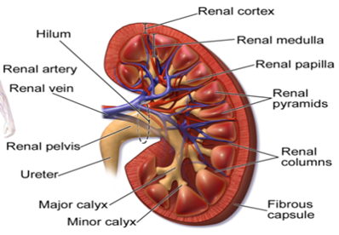
INTRODUCTION
Aditya College of Engineering & Technology
Chronic kidney disease, also called chronic kidney failure, involves a gradual loss of kidney function.
Your kidneys filter wastes and excess fluids from your blood, which are then removed in your urine.
Advanced chronic kidney disease can cause dangerous levels of fluid, electrolytes and wastes to build up in your body

Slide 5
LITERATURE REVIEW
Aditya College of Engineering & Technology
Author | Title | Year | Description | Advantage | Disadvantage
Abeer Y. Al-Hyari et al. | Kidney Disease Prediction using Data Mining Techniques | 2022 | Used ANN, Decision Tree & Naive Bayes for CKD prediction | High prediction accuracy | Limited feature interaction
P. Swathi Baby et al. | Prediction of CKD using Machine Learning Techniques | 2023 | Compared classifiers like RF, J48, K-Star using Weka/Orange | K-Star & Random Forest showed best results | Requires high-quality dataset
K.R. Lakshmi, Y. Nagesh et al. | Survival Prediction of Dialysis Patients | 2023 | Evaluated ANN, DT, Logistic Regression for dialysis survival prediction | ANN had the highest accuracy | Model complexity increases with data
Morteza Khavanin Zadeh et al. | Predicting AVF Failure in Hemodialysis Patients | 2022 | Used classification algorithms on real patient data | Early failure detection | Requires medical data access
Xudong Song et al. | Prediction Model for Kidney Disease Classification | 2024 | Used Decision Tree + Rough Set Theory for stage classification | Improved performance | Needs proper data preprocessing
Jicksy Susan Jose et al. | Image-based Kidney Diagnosis using Association Mining | 2023 | Diagnosed kidney conditions using image data and association rules | Extracted hidden patterns | Less effective on tabular health data
N. Sriraam, V. Natasha, H. Kaur | Dialysis Treatment Prediction using Association Mining | 2023 | Achieved 97.7% accuracy in treatment classification | Accurate recommendation engine | Doesn’t handle real-time prediction

Slide 6
EXISTING SYSTEM
Aditya College of Engineering & Technology
Manual Diagnosis: CKD prediction is traditionally done by manually testing and interpreting various health parameters, which is time-consuming.
Lack of Automation: There is no automated system to predict CKD, making the process inefficient and dependent on human intervention.
Delayed Results: Test reports often take a long time to generate, especially in under-equipped hospitals or rural areas.
Limited Accessibility: In some places, proper testing facilities and accurate reports are not available due to cost or lack of resources.
Risk in Emergencies: During critical situations, delayed diagnosis can put patients at high risk due to the absence of quick medical decisions.
No Decision Support: The existing approach doesn’t provide proper decision support for doctors or patients regarding CKD stages or treatment planning.
Difficult to Understand: For common people, interpreting test reports is difficult without medical assistance.

Slide 7
PROBLEM STATEMENT
Aditya College of Engineering & Technology
The project aims to develop a web application that provides users with accurate chronic disease predictions using AI-based models.
Unlike the existing manual diagnostic methods which are time-consuming, prone to human error, and often lack accessibility this system introduces automation and intelligent decision-making.
It ensures flexibility in finding the most efficient and accurate diagnostic paths.
The system is designed to overcome the limitations of the current approach by meeting both functional and non-functional requirements, ensuring accuracy, efficiency, and usability.
Comprehensive testing is conducted to verify that the system operates reliably before deployment, making it a robust alternative to traditional CKD prediction methods

Slide 8
PROPOSED SYSTEM
Aditya College of Engineering & Technology
To overcome the limitations of the existing manual and time-consuming methods for CKD prediction, the proposed system introduces an automated, AI-powered web application designed for accurate and early diagnosis.
Automation of Diagnosis: Unlike the manual methods, the proposed system automates CKD prediction, reducing the need for human intervention and minimizing errors.
Faster Results: The model generates predictions instantly upon input, eliminating delays in test result processing.
Accurate Decision-Making: By using trained ML algorithms, the system provides reliable predictions and stage classification, assisting doctors in clinical decisions.
Diet Recommendations: The application suggests personalized diets based on the patient's condition, which the current system does not support.
Accessibility and Scalability: Being a web application, it is accessible from any location, making it suitable for rural or under-resourced areas.
Data-Driven Insights: All user inputs and predictions are stored in a database, allowing for future data analysis and continuous system improvement.

Slide 9
Classification Algorithms
Aditya College of Engineering & Technology
Extra Trees Classifier:
An ensemble method using randomized decision trees for better predictions.
AdaBoost:
Combines weak learners (often small decision trees) into a strong learner by iteratively focusing on errors.
Gradient Boosting:
Sequentially builds models to correct errors from the previous models.
Decision Tree Classifier:
A simple model that splits data into branches based on feature thresholds.

Slide 10
Classification Algorithms
Aditya College of Engineering & Technology
Random Forest:
An ensemble of decision trees trained on different data samples and features.
Gaussian Naive Bayes:
A probabilistic model using Bayes' theorem and assuming feature independence.
K-Nearest Neighbors (KNN):
Classifies data points based on the majority class of their k-nearest neighbors.
Support Vector Machine (SVM):
Finds a hyperplane to separate data classes with maximum margin.

Slide 11
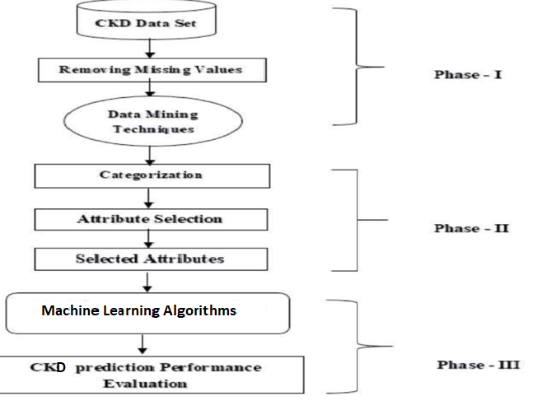
METHODOLOGY
Aditya College of Engineering & Technology

Slide 12
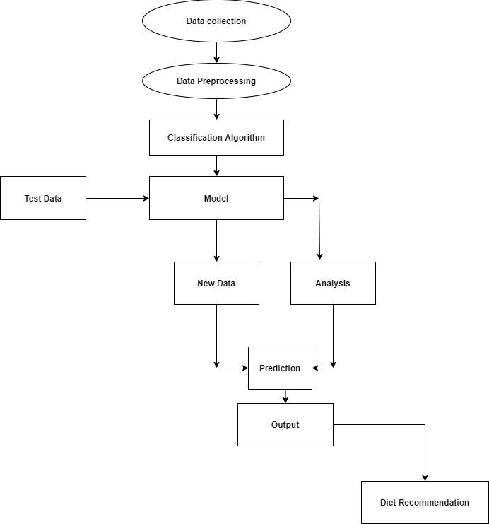
SYSTEM ARCHITECTURE
Aditya College of Engineering & Technology

Slide 13
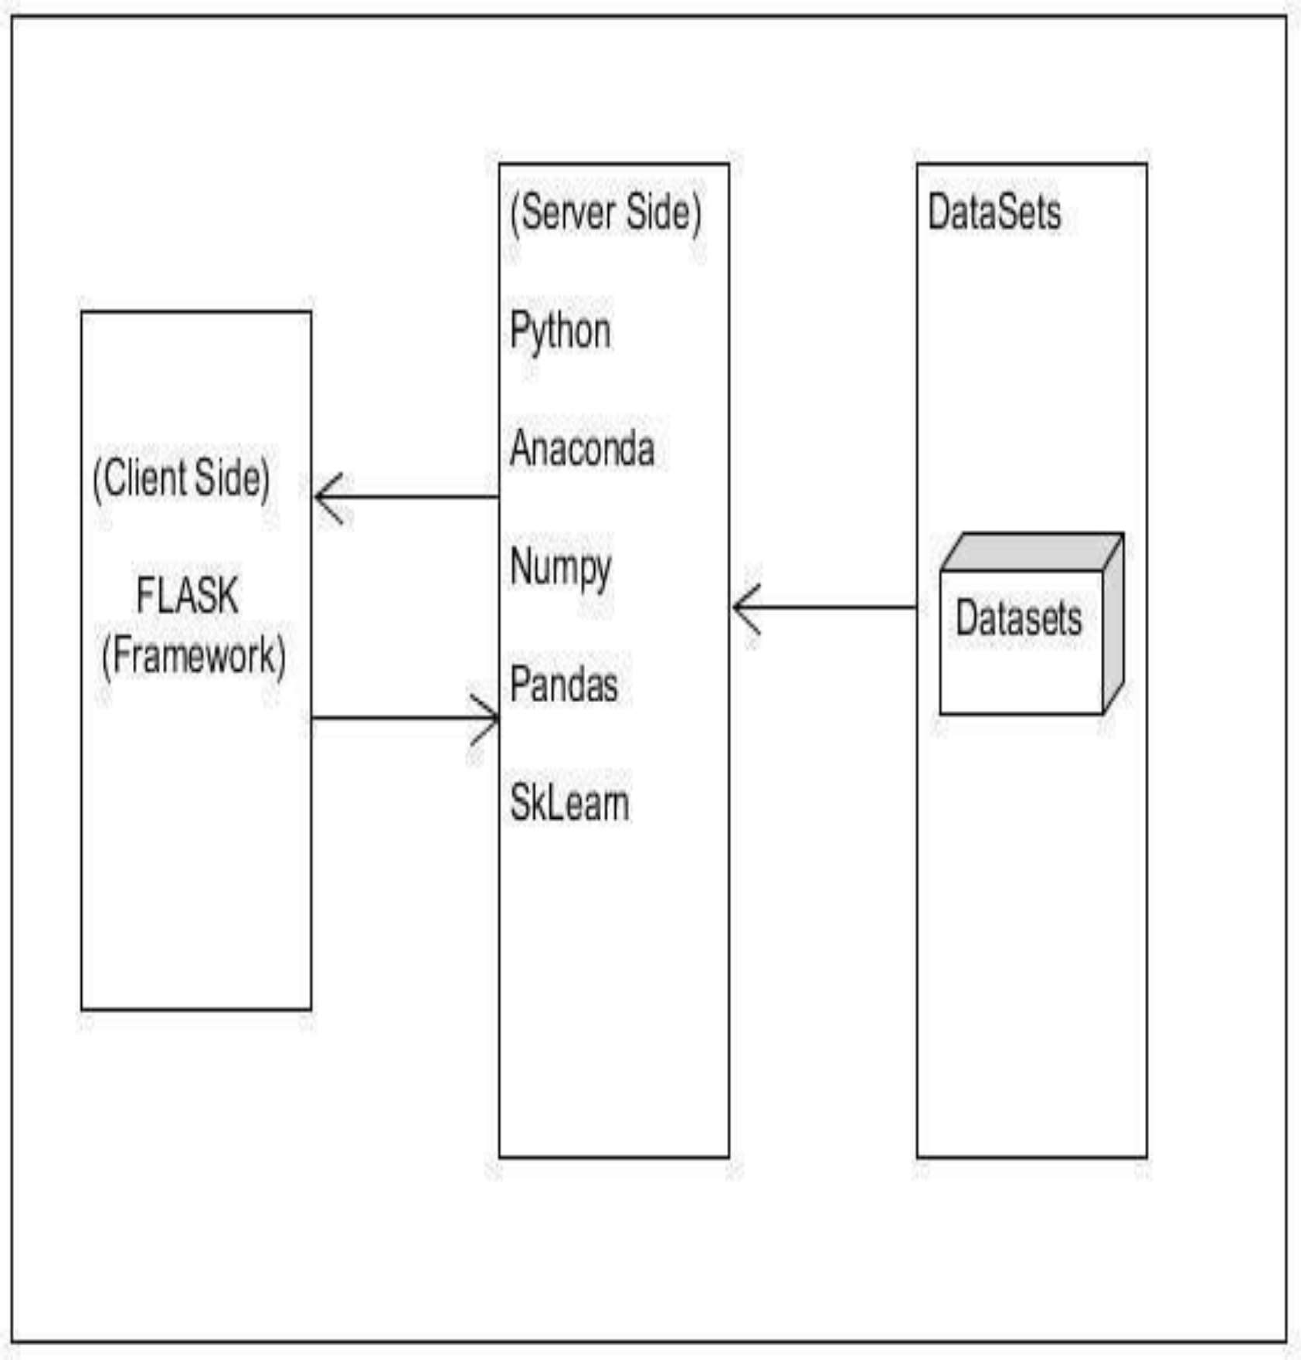
Aditya College of Engineering & Technology
Software Architecture

Slide 14
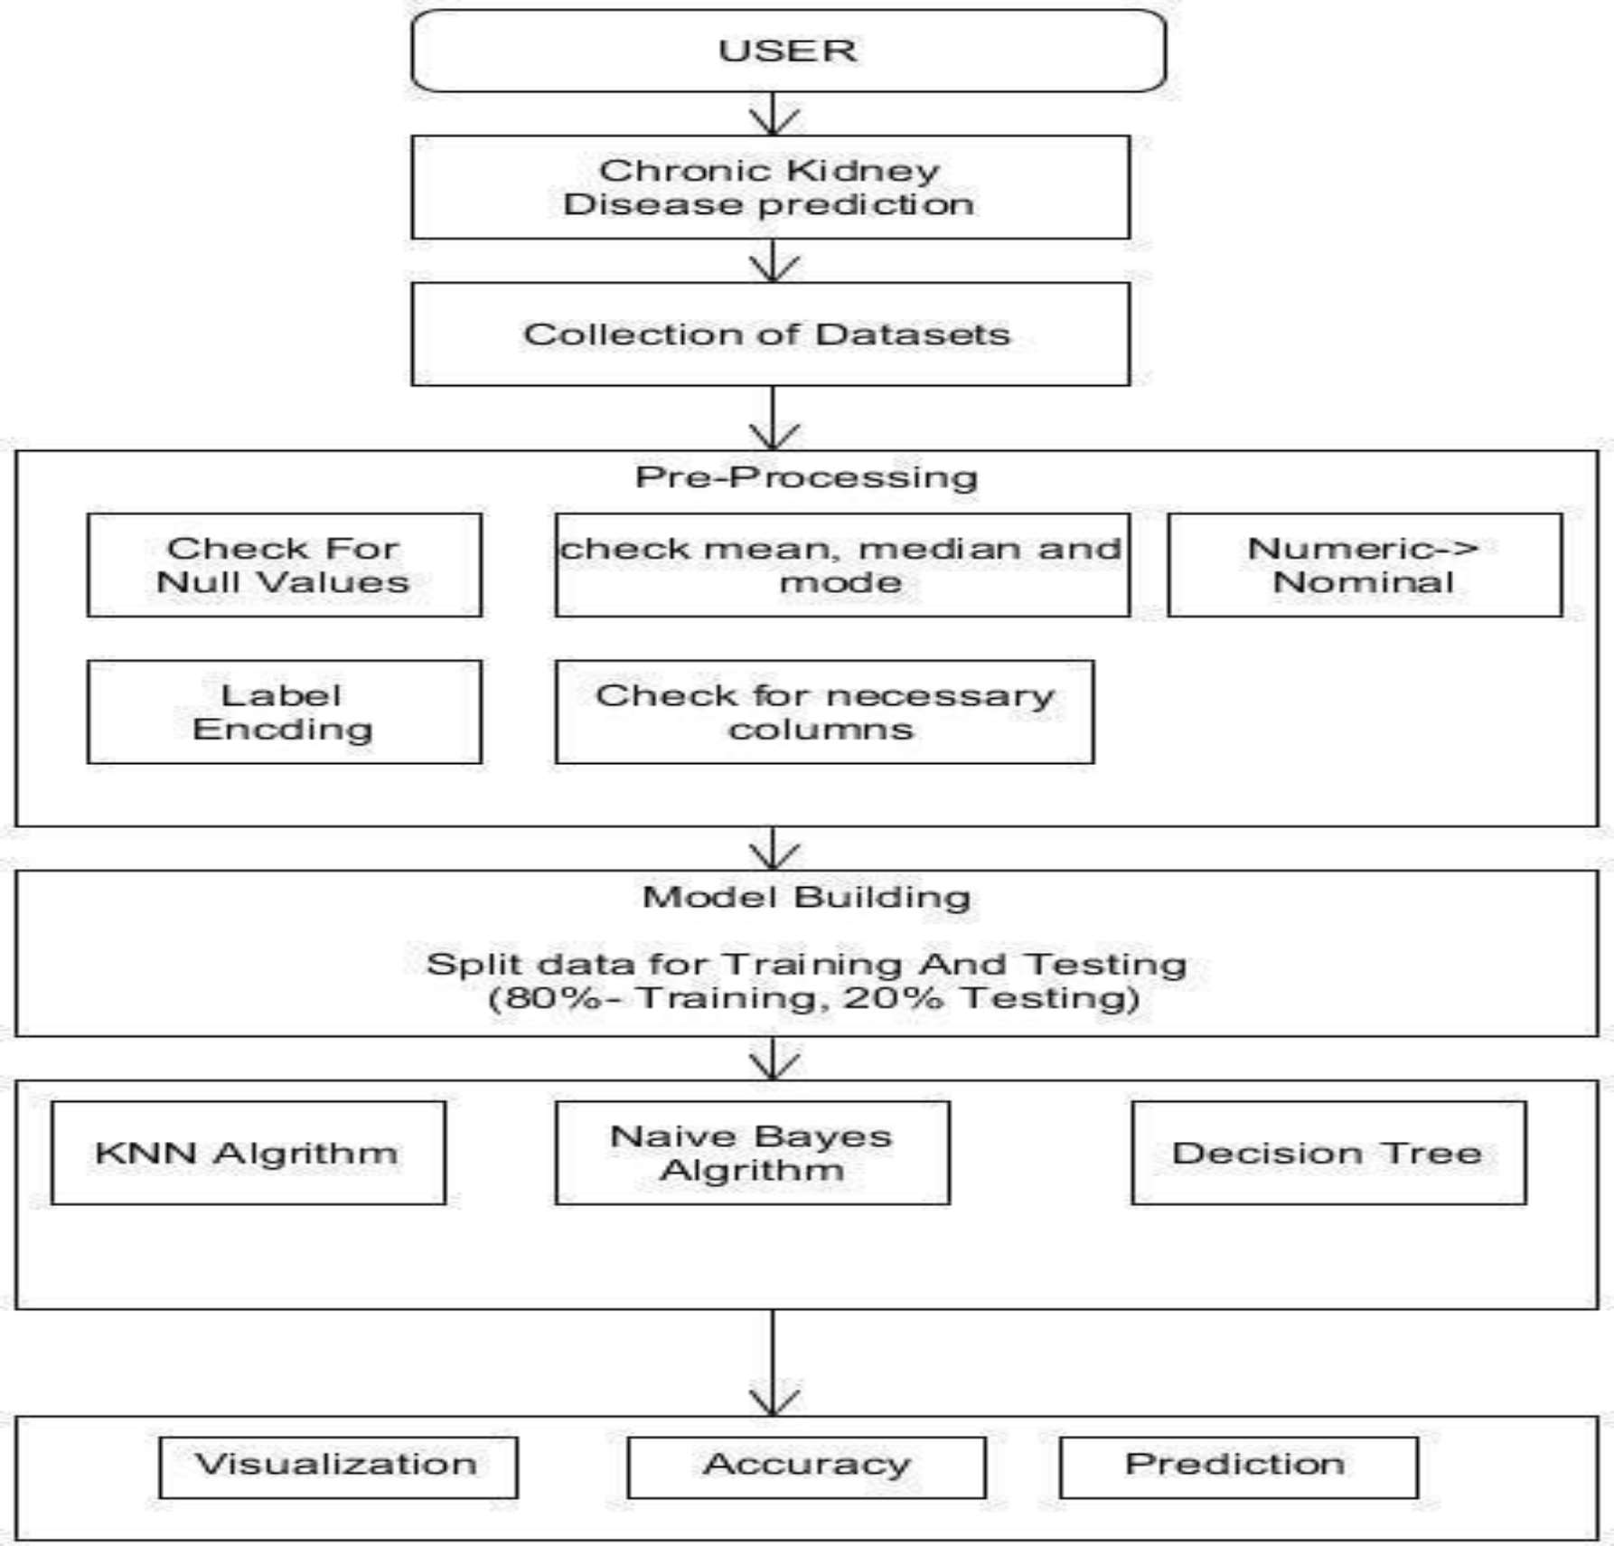
UML DIAGRAMS
Aditya College of Engineering & Technology
OVERVIEW

Slide 15
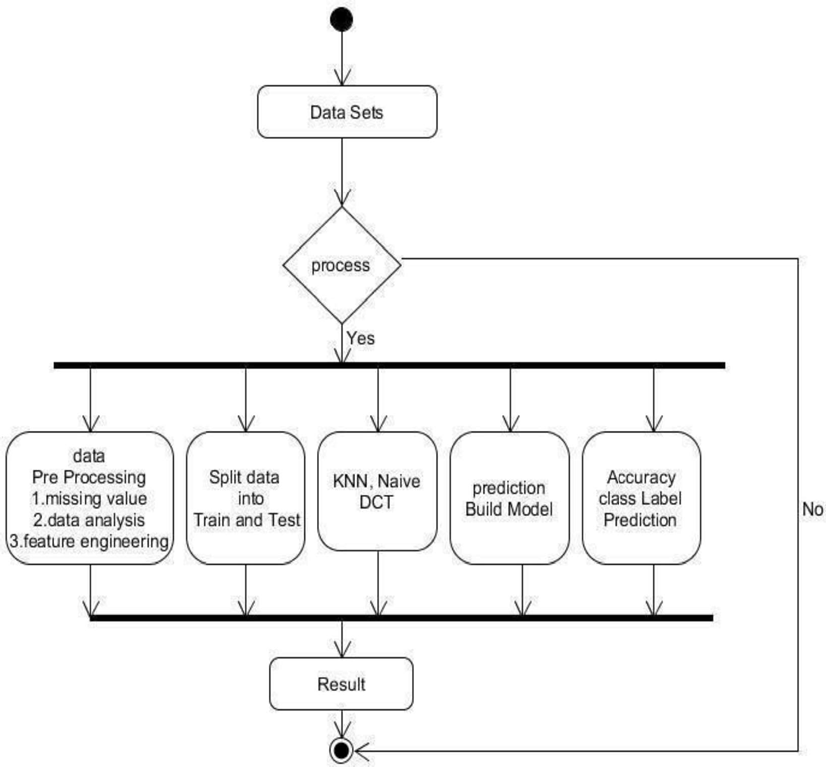
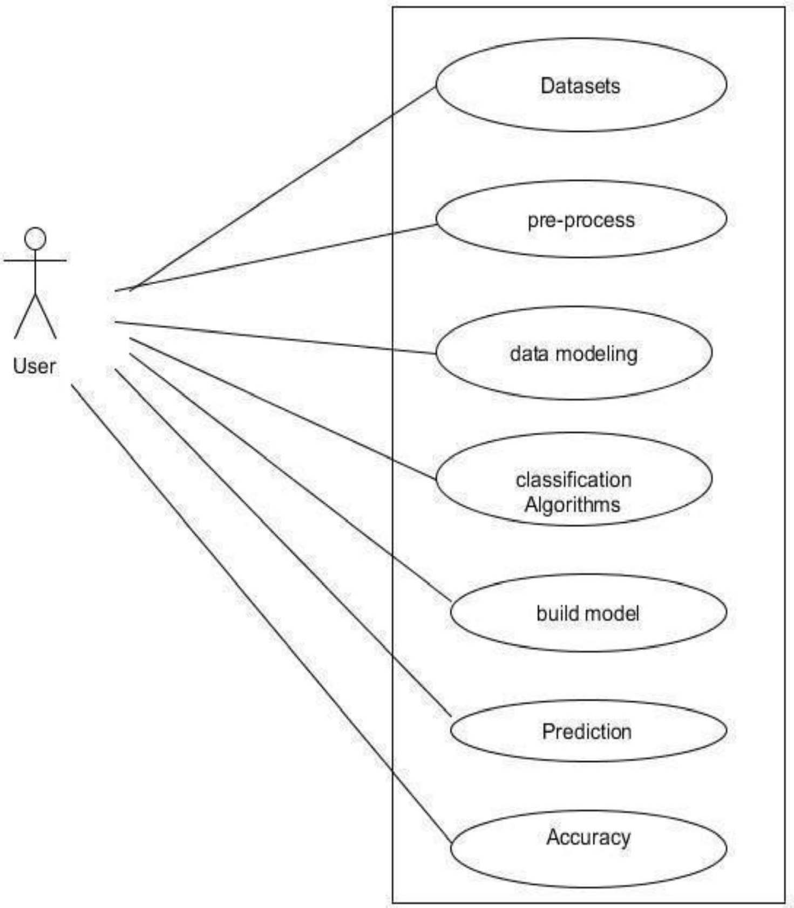
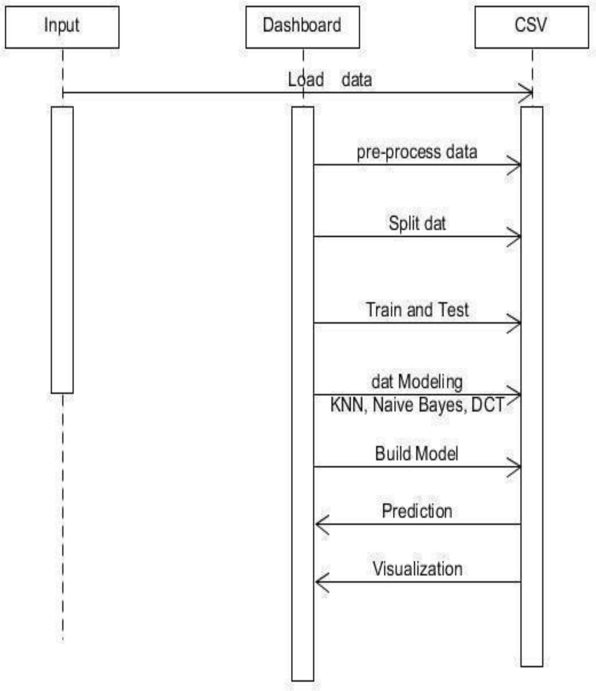
Aditya College of Engineering & Technology
Activity Diagram
Sequential Diagram
USE CASE DIAGRAM

Slide 16
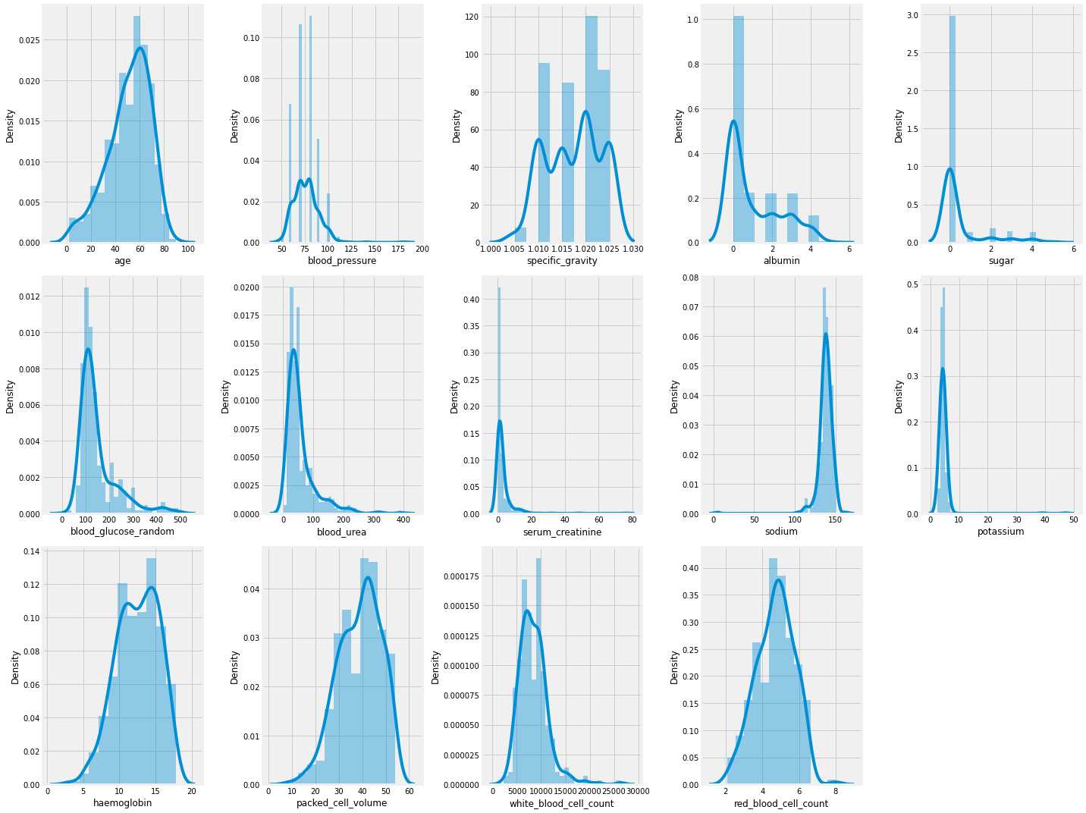
Aditya College of Engineering & Technology
Feature Distribution

Slide 17
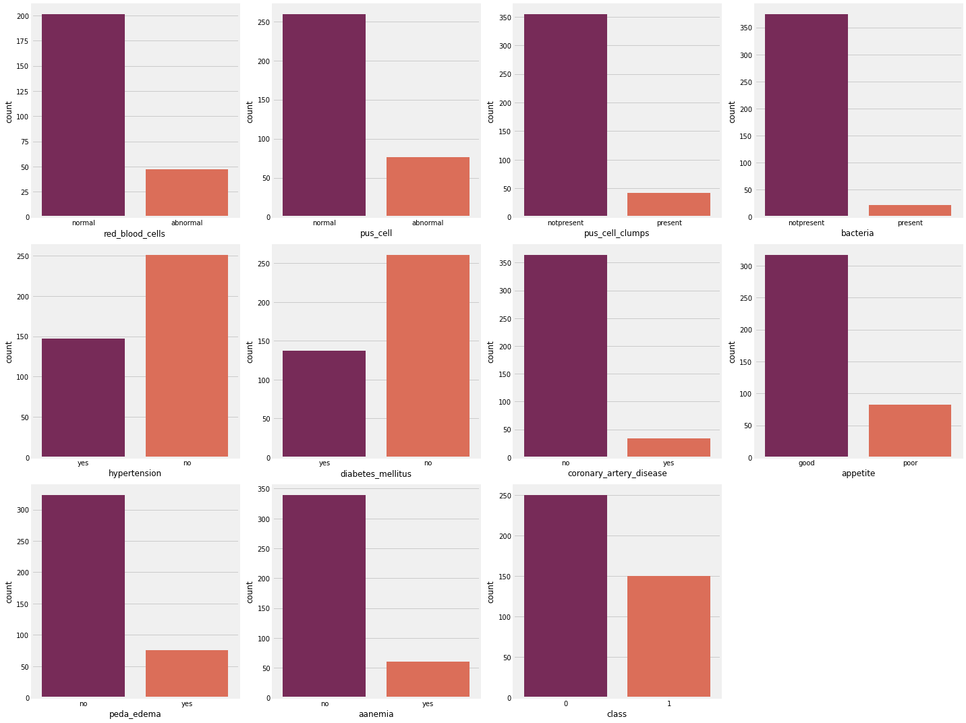
Aditya College of Engineering & Technology
Categorical Columns

Slide 18
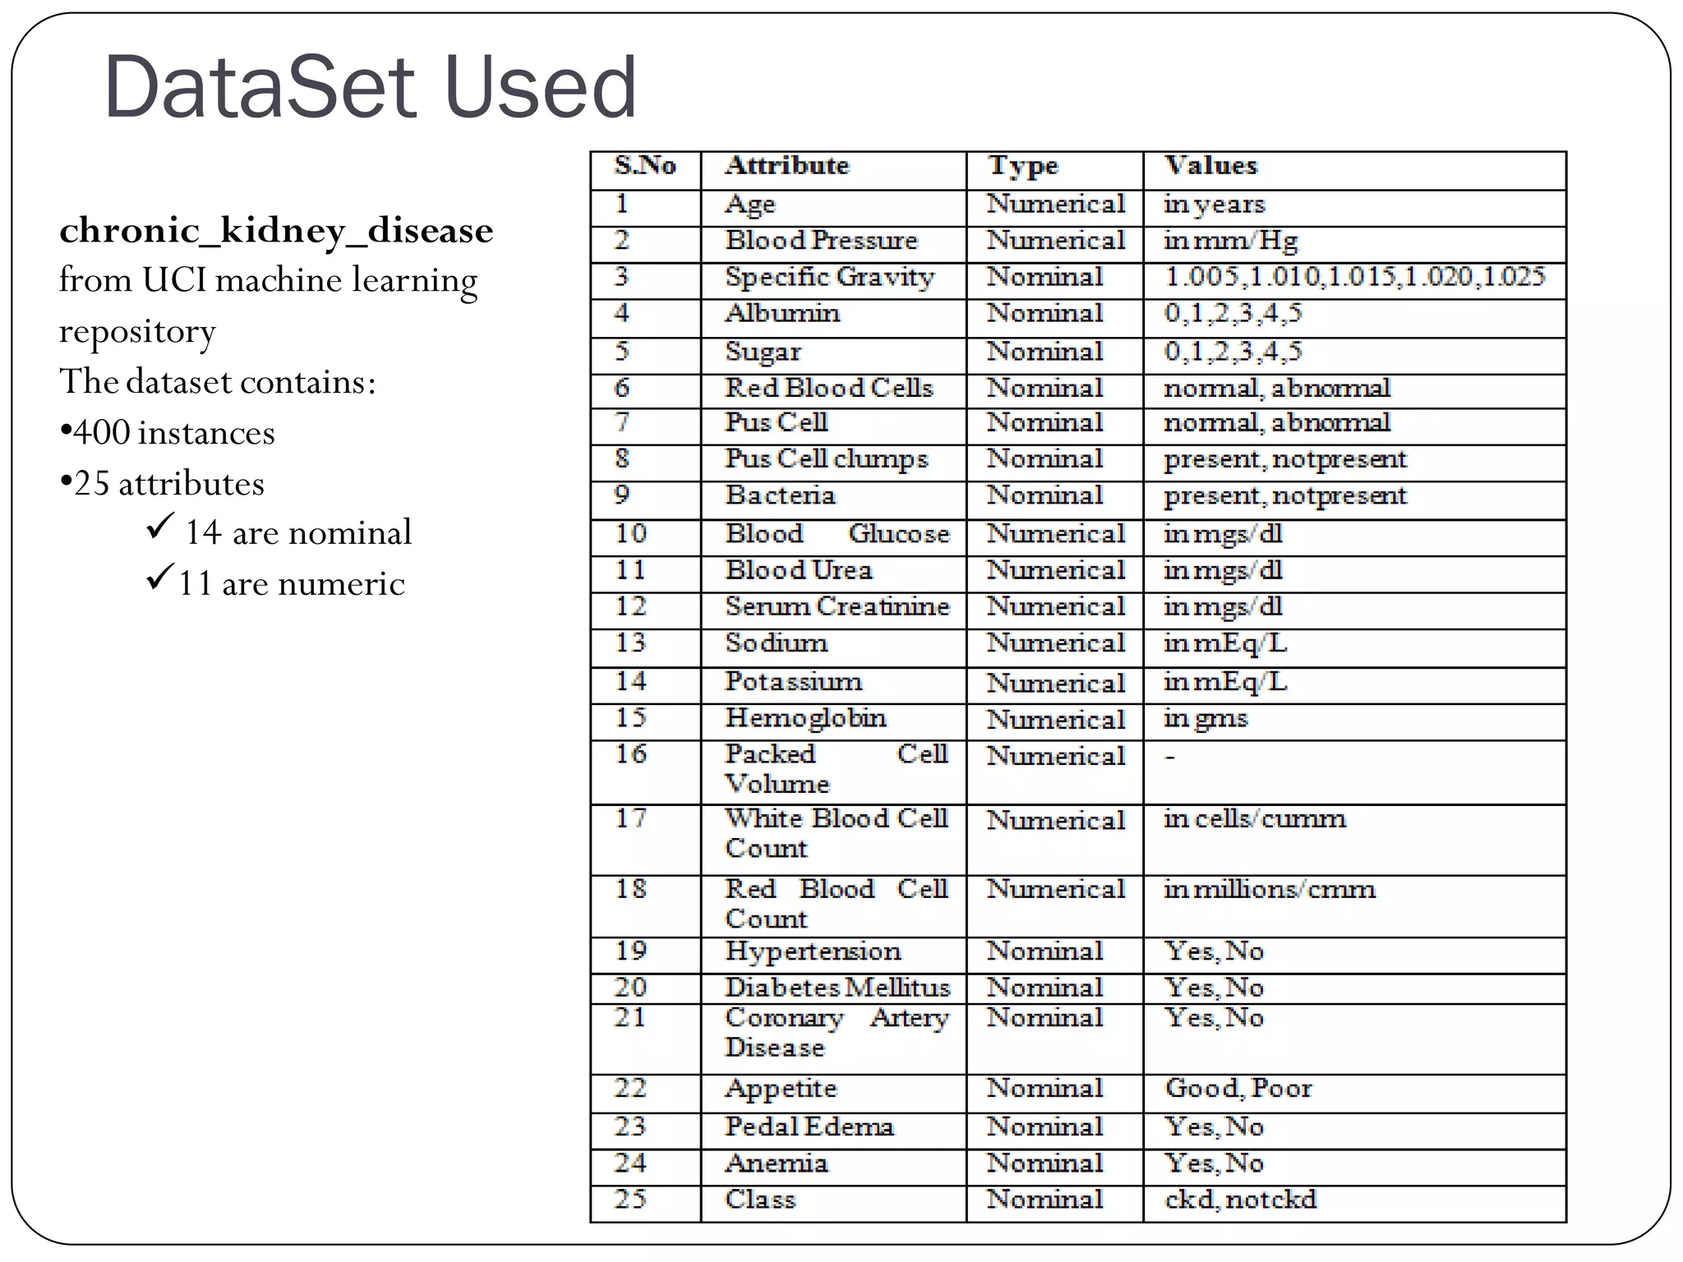
Aditya College of Engineering & Technology
Dataset Used

Slide 19
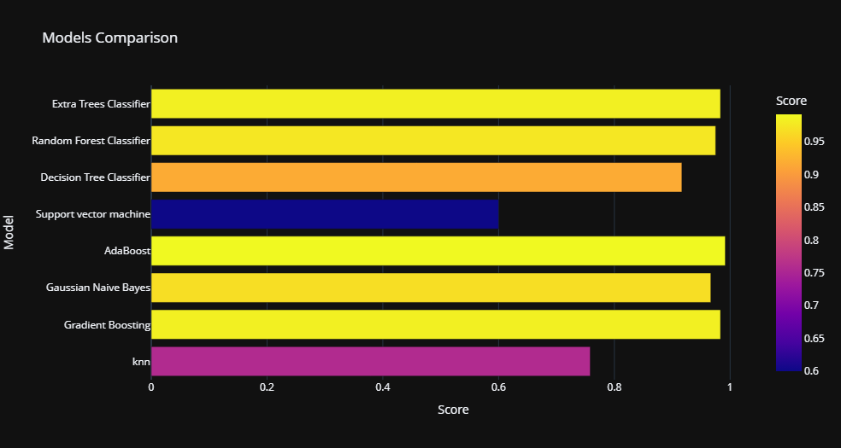
Aditya College of Engineering & Technology
Comparison of machine learning classifiers.
S.No Accuracy % Classifier
1. 99.1% Adaboost
2. 98.3% Gradient Boosting
3. 98.3% Extra Tree Classifier
4. 97.5% Random Forest Classifier
5. 96.6% Gaussian Naïve Bayes
6. 91.6% Decision Tree Classifier
7. 75.8% KNN
8. 60.0% Support Vector Machine

Slide 20
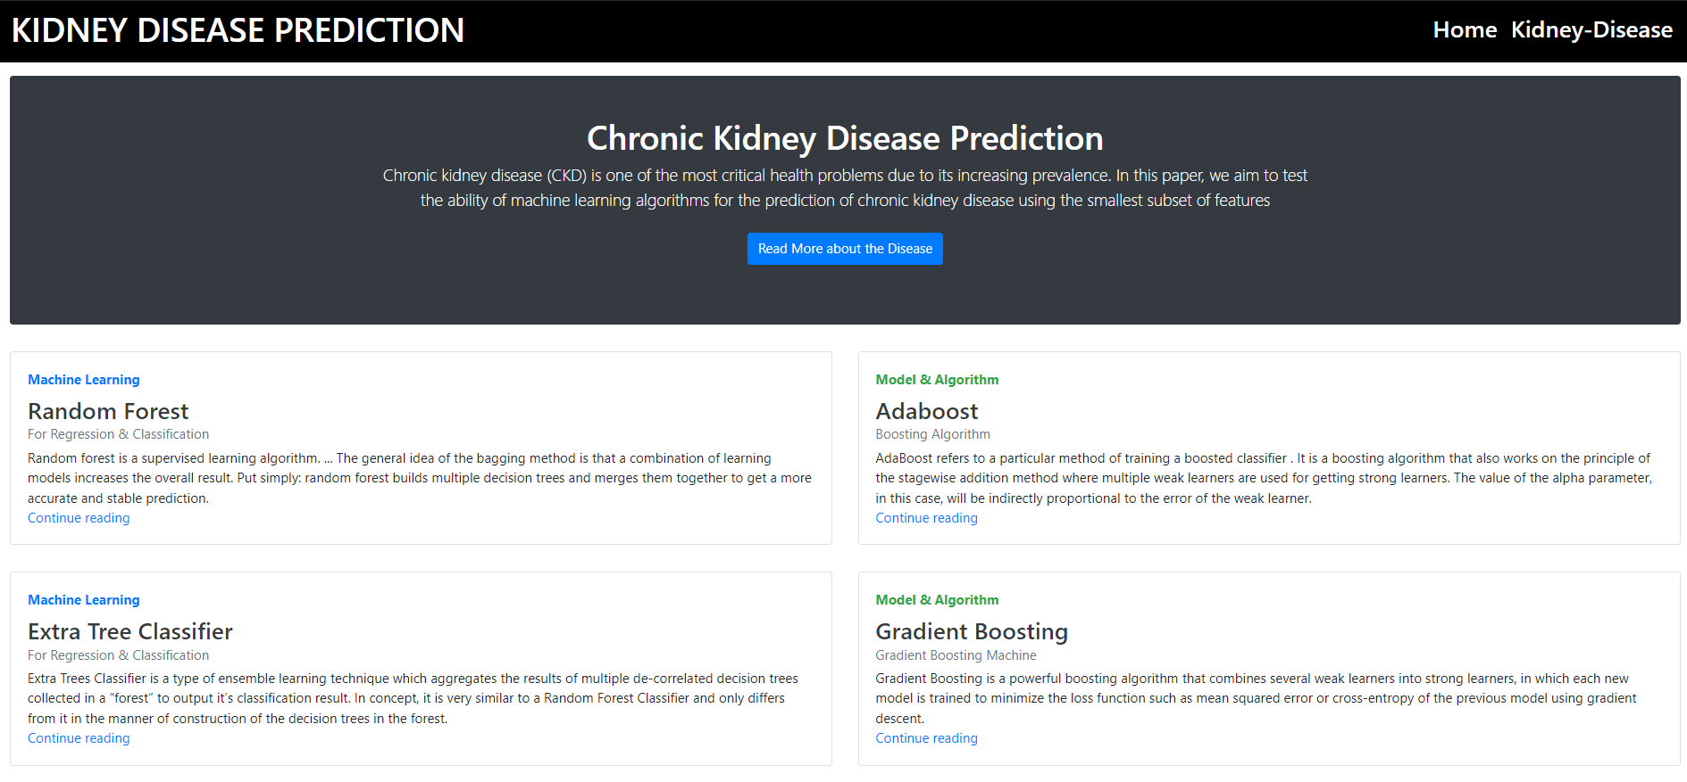
Aditya College of Engineering & Technology
Execution Screenshots
THE CHRONIC KIDNEY DISEASE PREDICTION AND DIET RECOMMENDATION SYSTEM USING MACHINE LEARNING TECHNIQUES

Slide 21
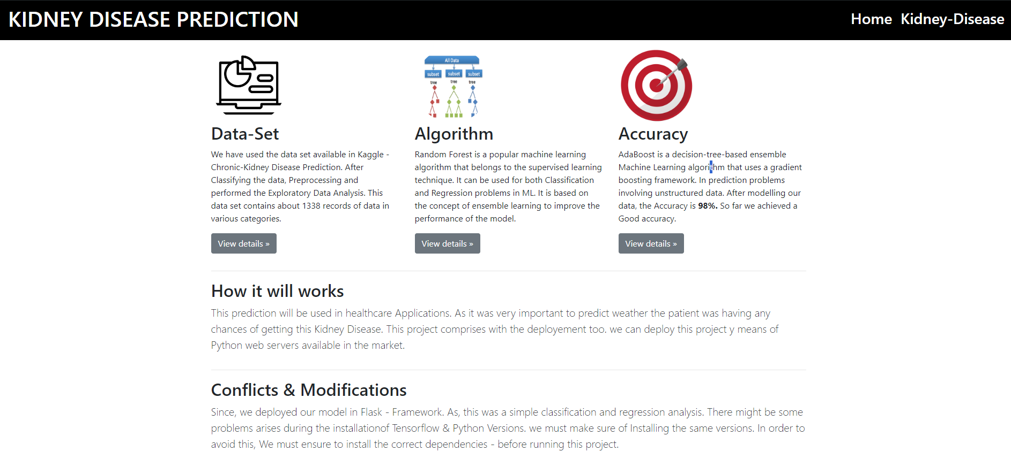
Aditya College of Engineering & Technology
Execution Screenshots
THE CHRONIC KIDNEY DISEASE PREDICTION AND DIET RECOMMENDATION SYSTEM USING MACHINE LEARNING TECHNIQUES

Slide 22
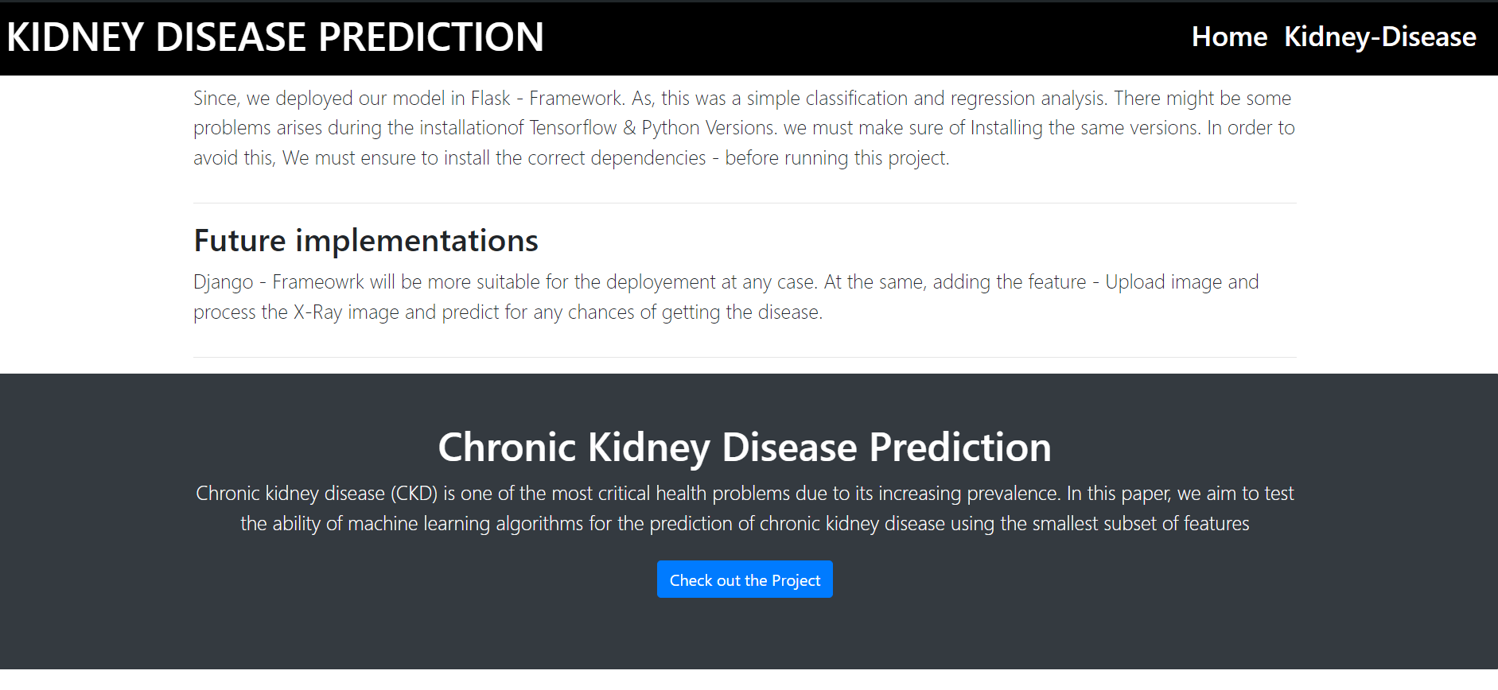
Aditya College of Engineering & Technology
Execution Screenshots
THE CHRONIC KIDNEY DISEASE PREDICTION AND DIET RECOMMENDATION SYSTEM USING MACHINE LEARNING TECHNIQUES

Slide 23
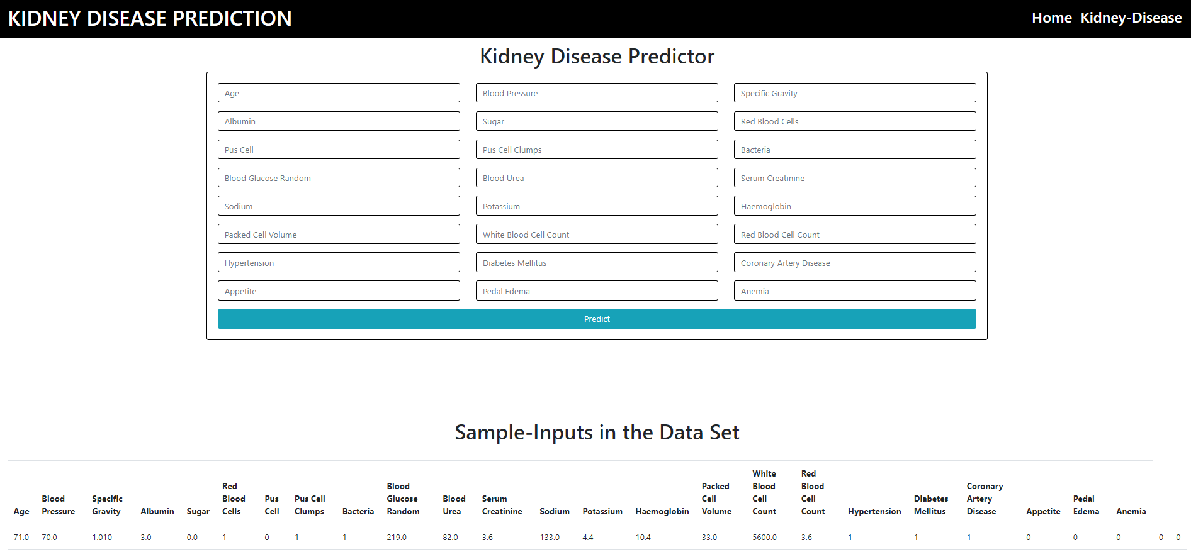
Aditya College of Engineering & Technology
Execution Screenshots
THE CHRONIC KIDNEY DISEASE PREDICTION AND DIET RECOMMENDATION SYSTEM USING MACHINE LEARNING TECHNIQUES

Slide 24
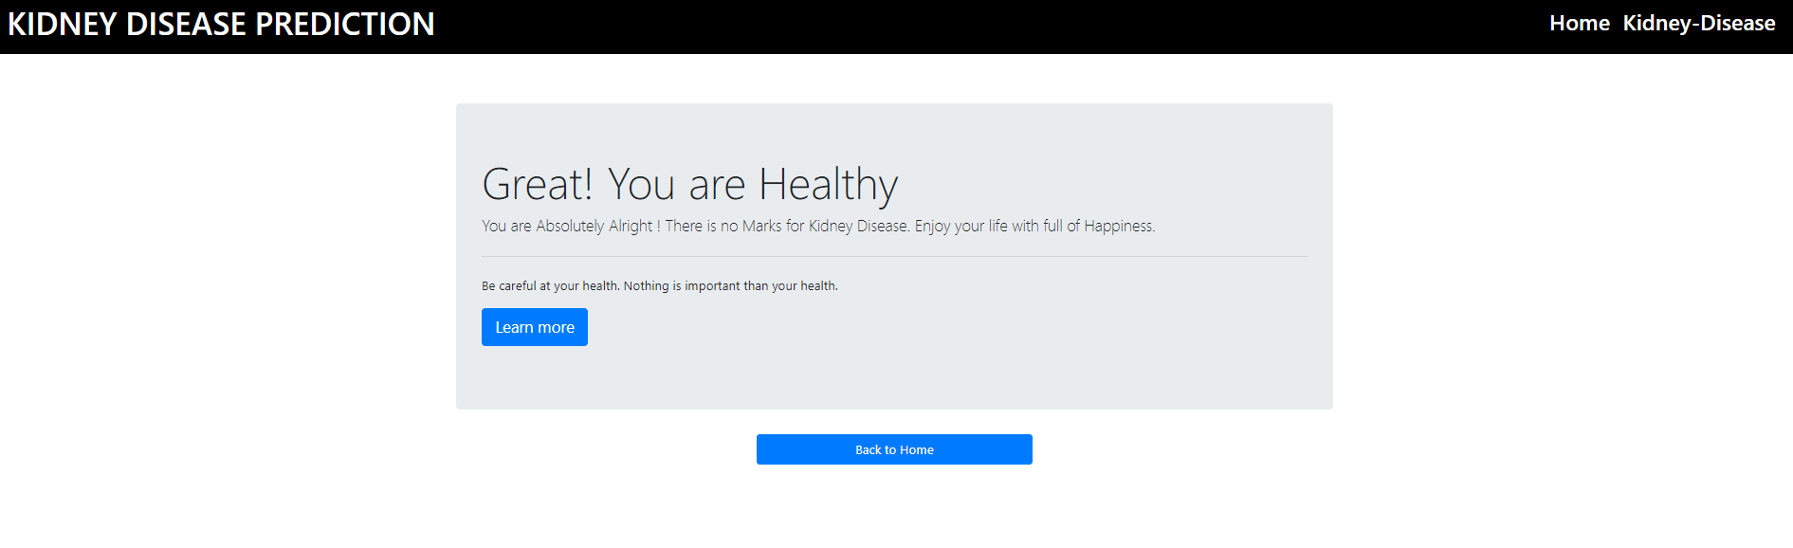
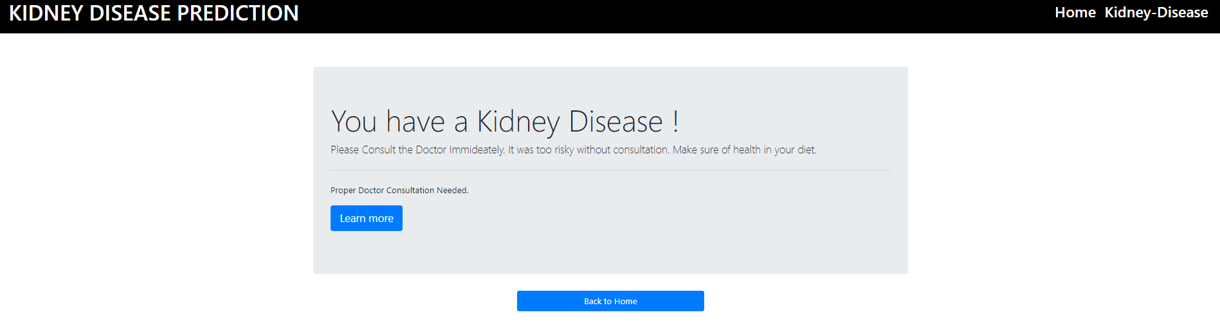
Aditya College of Engineering & Technology
Execution Screenshots
THE CHRONIC KIDNEY DISEASE PREDICTION AND DIET RECOMMENDATION SYSTEM USING MACHINE LEARNING TECHNIQUES

Slide 25
CONCLUSION
Aditya College of Engineering & Technology
This study highlights the effectiveness of machine learning techniques in predicting Chronic Kidney Disease (CKD), improving early detection and medical decision-making. Research confirms that decision trees, random forests, neural networks, and ensemble learning methods significantly enhance prediction accuracy. Feature selection, data preprocessing, and boosting techniques further refine model performance. As machine learning continues to evolve, these advancements contribute to more precise and reliable CKD diagnosis, ultimately improving patient outcomes and healthcare efficiency.

Slide 26
REFERENCES
Aditya College of Engineering & Technology
Al-Hyari, A. Y., Alhawarat, M. K., & Al-Zoubi, M. A. (2022). Kidney Disease Prediction using Data Mining Techniques. Utilized ANN, Decision Tree, and Naive Bayes algorithms for effective CKD prediction.
Swathi Baby, P., & Prasad, T. V. D. (2023). Prediction of Chronic Kidney Disease using Machine Learning Techniques. Compared AD Tree, J48, K-Star, and Random Forest using Weka and Orange tools.
Lakshmi, K. R., Nagesh, Y., & VeeraKrishna, M. (2023). Survivability Prediction of Dialysis Patients using Machine Learning Techniques. Investigated ANN, Decision Tree, and Logistic Regression for survival outcomes.
Zadeh, M. K., & Others. (2022). Predicting Arteriovenous Fistula Failure in Hemodialysis Patients using Classification Techniques. Employed supervised learning for early AVF failure detection.

Slide 27
REFERENCES
Aditya College of Engineering & Technology
Song, X., & Others. (2024). A Weighted Region-Based Classification Algorithm using Decision Trees and Rough Set Theory. Applied for kidney disease stage classification based on GFR values.
Jose, J. S., & Others. (2023). Kidney Image-Based Diagnosis using Association Rule Mining. Implemented association rules for classifying kidney disease patterns from medical images.
Sriraam, N., Natasha, V., & Kaur, H. (2023). Dialysis Treatment Prediction using Association Mining Techniques. Achieved 97.7% accuracy in patient treatment prediction for CKD.

Slide 28
Future Scope
Aditya College of Engineering & Technology
Integration of Deep Learning: Enhance prediction accuracy by incorporating advanced models like CNNs and RNNs.
Mobile Application Development: Extend the system into an Android app for wider accessibility and real-time usage.
Expanded Dataset and Features: Use larger and more diverse datasets with additional medical parameters for improved reliability.
Personalized Health Recommendations: Add modules for health and diet suggestions based on individual disease stages and status.

Slide 29
Aditya College of Engineering & Technology
THANK YOU!

